Slide 1
Algorithms, Big-O, Psuedocode, Searching, Sorting

Slide 2
What are Algorithms?
Any series of steps taken to solve a problem is an algorithm.
Some problems occur a lot in programming: sorting sets of data, searching data for particular values, finding relationships between data, etc.
Solving a problem requires balancing resources available
Memory space
Execution time
Algorithms are typically generic steps independent of the data provided. Sort(x), it doesn’t matter if x is numbers or people.

Slide 3
Creating Algorithm
‘Algorithm’ is often a buzzword, but its just a step-by-step approach to solving a problem.
Following directions to bake a cake
Giving directions to get to your house
If you have an array of numbers, and you want to sort them from lowest to highest. How do you do it?
There is no programming tricks here:
Break the problem down
Talk it out, like you're explaining it to a child.
Use Psuedocode
Practice!

Slide 4
Pseudocode
Planning and organization are key to creating efficient algorithms. To plan the logic for an algorithm, pseudocode is often used.
Pseudocode is an informal, artificial, text-based, and self-descriptive language that is used to describe the steps of an algorithm prior to the actual implementation.
In other words, pseudocode is used to explain the steps of an algorithm without worrying about the specific programmatic syntax/grammar (pseudocode cannot be compiled or executed).

Slide 5
Pseudocode – How to…
Limit one statement per line
All statements showing “dependencies”/”hierarchies” are indented (i.e. flow control statements and their associated blocks of code).
Statements are language agnostic (refrain from using keywords specific to a particular programming language)
Describe with words rather than programmatic symbols
Keep it simple, concise and readable.

Slide 6
Pseudocode - Examples
Not Bad:
(could be better)
Better:
(even now could still be improved)
if arrayNotNull = true
for y = 0 to arrayLength-1
if (array[index] = odd)
print
array[index]
if array is not null
for each element of array
if array index value is odd
print
value of array index
input double[] scores
output double average
int total = 0
int count = 0
if scores.length > 1
while count < scores.length-1
total += scores[index]
count++;
return total/count;
input: array of scores as doubles
output: average as double
initialize total to zero
initialize count to zero
if array length greater than 1
while count is less than array length
add array index to total
increment count
return total divided by count

Slide 7
Psuedo Code – Palindrome Algorithm
algorithm palindrome is input: string phrase output: true/false result
initialize length to length of phrase initialize c to zero
while c LEqual to length/2 if phrase[c] Nequal phrase[length - 1 – c] return false increment c
return true

Slide 8
Common Algorithms – Linear Search
Searching algorithms are methods used to find an element within some collection or list.
Linear search is the most basic searching algorithm, which functions by checking each element of a collection in sequence until a match is found or until the whole list has been searched.

Slide 9
Linear Search
public static int linearSearch(int target, int[] collection) {
int index = -1;
for (int i = 0; i < collection.length; i++) {
if (collection[i] == target) {
index = i;
}
}
return index;
}

Slide 10
Common Algorithms – Binary Search
A Binary Search (a.k.a. half-interval search) is another common algorithm used to find elements within a sorted collection.
Binary search finds the position of an element by looking at the element halfway between the recognized minimum and maximum value and eliminating half of the remaining elements if the target value is less than or greater than this halfway point.
The algorithm ends after finding the target value is found or all elements have been eliminated.

Slide 11
Binary Search
public static int binarySearch(int target, int[] collection) {
int left = 0;
int right = collection.length-1;
while (left <= right) {
int mid = (right+left)/2
if (target < collection[mid]) {
right = mid - 1;
} else if (target > collection[mid]) {
left = mid + 1;
} else {
return mid;
}
}
return -1;
}

Slide 12
Common Algorithms – Bubble Sort
Bubble Sort is one of the simplest sorting algorithms, used to organize elements of a collection into a particular order.
Bubble Sort organizes elements by repeatedly comparing and swapping adjacent elements if they are in the wrong order.

Slide 13
Bubble Sort
public static void bubbleSort(int[] arr) {
int n = arr.length;
for (int i = 0; i < n – 1; i++) {
for (int j = 0; j < n - 1; j++) {
if (arr[j] > arr[j+1]) {
int temp = arr[j];
arr[j] = arr[j+1];
arr[j+1] = temp;
}
}
}
}

Slide 14
Common Algorithms – Selection Sort
Selection Sort is another common sorting algorithm that organizes elements within a collection.
The Selection Sort works by repeatedly finding the smallest element of a collection and moving the found element forward by swapping the position of the left-most element, with the smaller.

Slide 15
Selection Sort
public static void selectionSort(int[] arr) {
int n = arr.length;
for (int i = 0; i < n – 1; i++) {
int minIndex = i;
for (int j = minIndex+1; j < arr.length - 1; j++) {
if (arr[minIndex] > arr[j]) {
minIndex = j;
}
}
int temp = arr[i];
arr[i] = arr[minIndex];
arr[minIndex] = temp;
}
}

Slide 16
Measuring Algorithms
Algorithms are designed independent of the inputs they are given. An algorithm isn’t designed differently if it only sorts 5 objects instead of 500.
…but we have to respect resources used. The same algorithm will likely take longer to sort 500 elements than it would to sort 5.
…but how much longer? How quickly/slowly do the time requirements grow as the number of inputs grows?
Algorithms are measured by the relative rates that they consume resources as their inputs grow. We sometimes call this efficiency or complexity.

Slide 17
Big-O Notation
An algorithm does something to inputs that are provided. More inputs, more steps to complete.
Inputs are called “n”. Algorithms are expressed as a function describing how quickly they grow as ‘n’ increases.
The function O is used to express how the algorithms grow as ‘n’ approaches infinity. Sometimes called the “worst-case” growth.
For example, O(n) function grows linearly with n. As n increases, the number of steps required increases a proportionate amount.

Slide 18
Big-O and Math
Big-O can involve a bit of limit calculus and algebra. This is the science of computer science.
In most circumstances, you can avoid the crunchy mathematical details if you understand the rules involved.
Deducing the complexity of an algorithm can be done through pattern recognition much of the time.
We’ll try to keep it approachable, but algorithms are important.

Slide 19
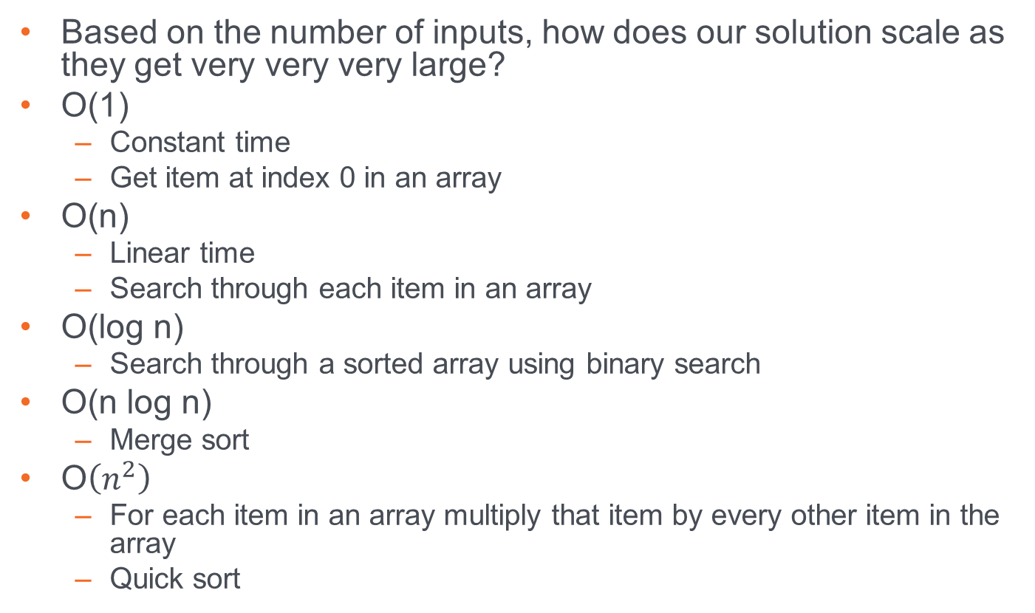
Big-O
Based on the number of inputs, how does our solution scale as they get very very very large?
O(1)
Constant time
Get item at index 0 in an array
O(n)
Linear time
Search through each item in an array
O(log n)
Search through a sorted array using binary search
O(n log n)
Merge sort
O$\left(n^{2}\right)$
For each item in an array multiply that item by every other item in the array
Quick sort

Slide 20
Practice Makes Perfect
The only real way to get more proficient creating algorithms is to practice and work through different problems.
The links below are some popular resources that provide algorithm practice problems.
https://www.hackerrank.com/
https://www.codingame.com/
https://leetcode.com/
https://codesignal.com/

